Slide 1

Descriptive clustering: assisting domain experts
Sahithya Ravi

Slide 2

GOALS
How can we create similar groups (clusters) which are meaningful and interpretable?
Can these groups improve the speed of decision-making?
Can interpreting these groups help in better investigation of certain predictions?

Slide 3
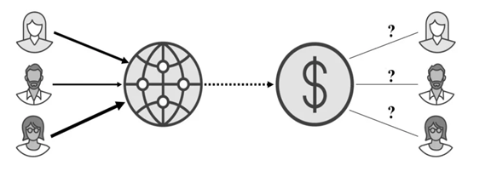
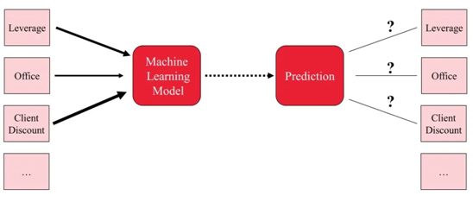
SHAPELY VALUES
Game theory
EXPLAINABILITY
Used in game theory: How to fairly distribute payout among multiple players with different skills?
How to fairly distribute a prediction among different features?

Slide 4
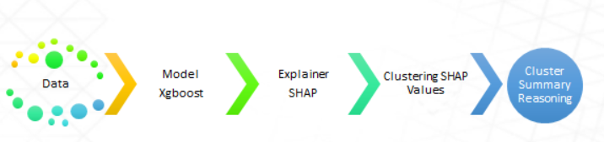
Clustering approach
Clustering is usually performed in feature space
Instead, If we cluster instances by explanation similarity:
improve cluster homogeneity
improve understanding of model by expert
Guide the expert in decision making
STEPS: Generate clusters -> explain the clusters
Pipeline of steps for explainable clustering

Slide 5
Models
We generated explainable clusters based on different models & datasets:
Dataset | Type | Models
Sentiment analysis (hate speech, customer reviews) | text | SVM, Gradient Boosting classifiers, LSTM
CIFAR, covid x-ray severity | image | VGG-16, DenseNet

Slide 6
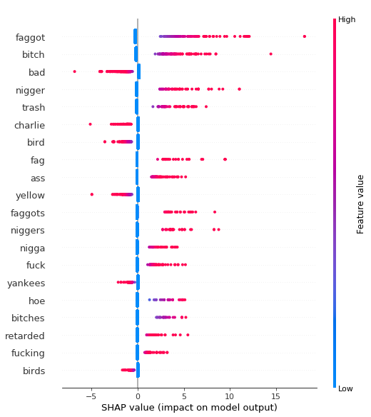
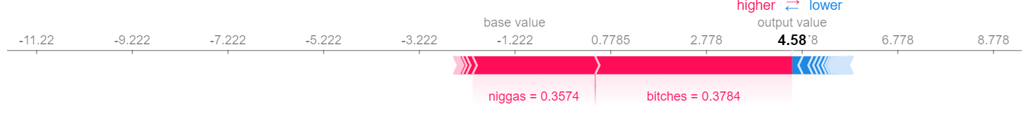
Shapely explanations
Global summary of features for Hate-speech
Explanation of a single instance for hate-speech
niggas wear wigs more than bitches these days
prediction: HATE
True label : HATE

Slide 7
Clustering approach
We cluster instances based on model explanations (shapely values).
Instances within the cluster have similar explanations and key contributors to prediction.
For example take a look at these clusters from sentiment analysis:
https://chart-studio.plotly.com/~sahismiley11/38/#/
Homogeneity score = 0.7, meaning 70% of the clusters are pure. This can be improved based on number of clusters and the model used.

Slide 8
Cluster size and homogeneity
No of clusters can be chosen based on homogeneity score and the number of instances per cluster a domain expert can effectively handle
Fig. shows homogeneity and completeness for clustering 500 instances from hate-speech analysis dataset.
Minimum required cluster size to have reasonable homogeneity score in this case:

Slide 9
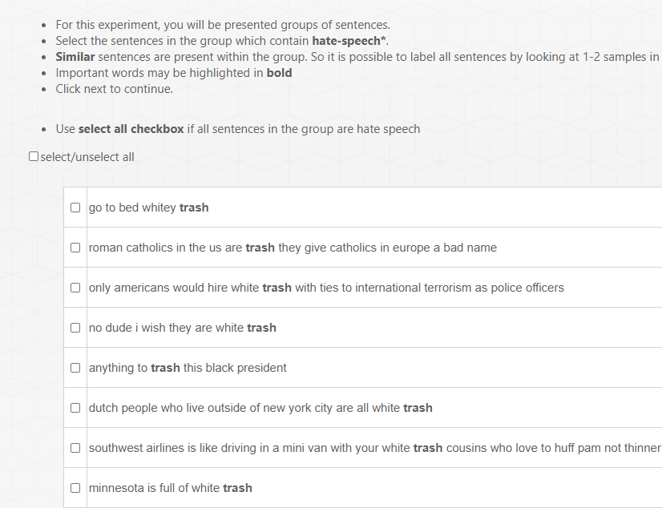
Application #1 : Smart annotation
Snap shot from guided annotation tool
Train a model based on a small amount of available data (say 50% of the dataset)
Use model explanations to generate cluster unlabeled data pool into batches.
This will group instances into homogenous batches which are easier to annotate.
Highlight top 1-5 key features
Results in a 3x improvement in annotation speed when compared to individual labelling.

Slide 10
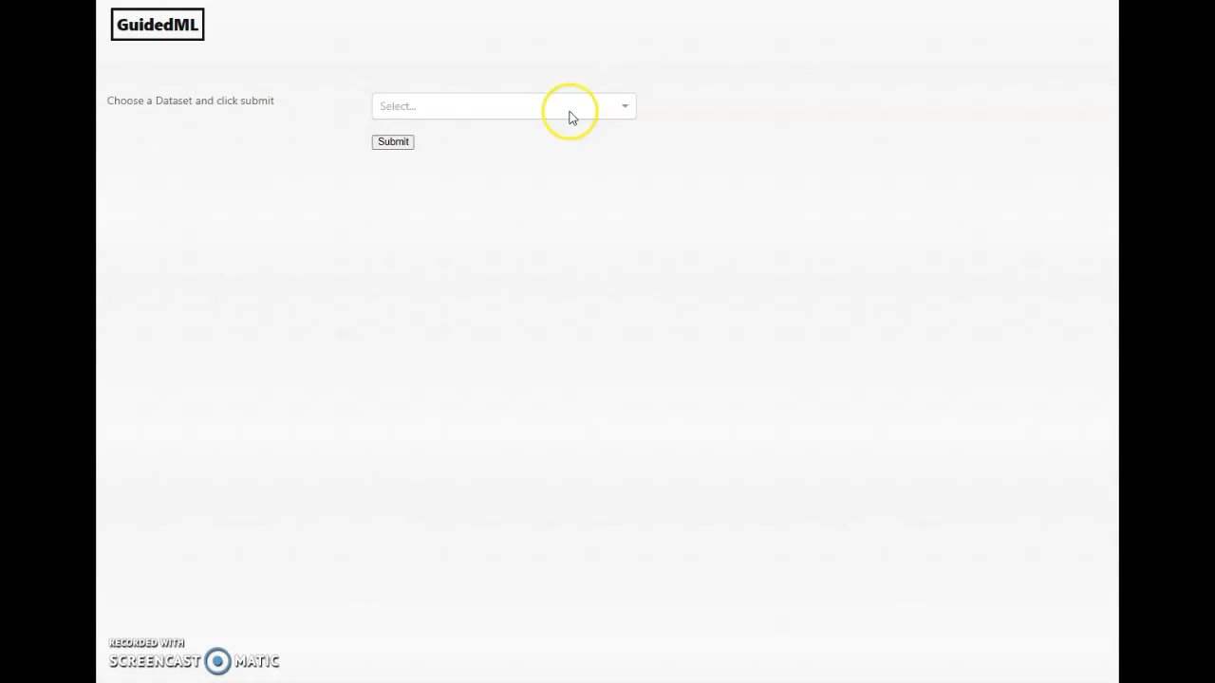
Short demo of a simple dataset from guided annotation tool

Slide 11
Application #2 : Explore prediction
Train a model based on a larger amount of available data (say 70% of the dataset)
Use model explanations to cluster unlabeled data pool into batches.
Explore the features of impure clusters to understand why false positives or false negatives may occur.

Slide 12
Future direction
Exploring uncertainity with explainability
How can we estimate uncertainity?
How is the confidence of the model related to clusters based on model explanations?
Can we rank the explainable clusters or batches based on uncertainity

